Slide 1
KB Economic Forum Economic outlook and investment Strategy
November 8th, 2023
Clémentine Gallès Chief Economist & Strategist Société Générale Private Banking

Slide 2
Economic outlook and investment Strategy
Opposite risks that intensify
We stand by our central scenario of a slowdown in economic activity
Maintaining our balanced strategic positioning in a turbulent environment

Slide 3
Opposite risks that intensify renewed geopolitical risks

Slide 4
Opposite risks that intensify Renewed bond market tensions

Slide 5
Walking on a tightrope between risks
We stand by our central scenario of a slowdown in economic activity
US economy to continue to hold up better
Inflation to decrease slowly
Central banks: high rates for longer
Lower interest rate scenario
Sharper economic slowdown
Inflation to decrease more rapidly
Central banks: a more rapid pivot
Higher interest rate scenario
Geopolitical and energy prices tensions
Stronger economic activity
Complex implementation of Quantitative Tightening
Expansion
Contraction

Slide 6
Inflation to decrease slowly

Slide 7
Central banks: high rates for longer

Slide 8
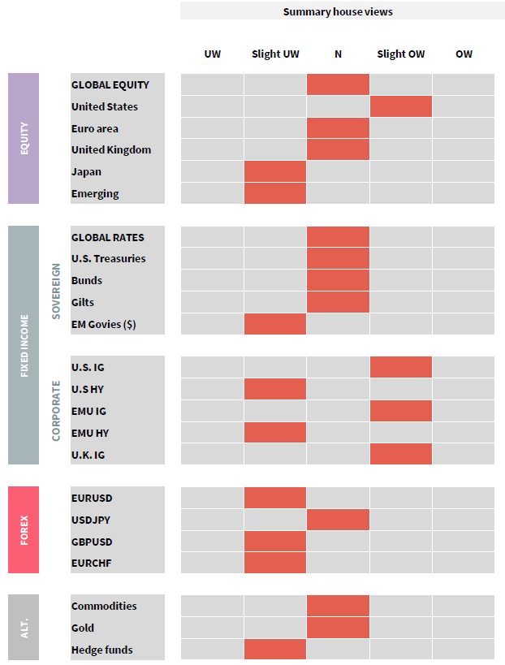
Playing the diversification card

Slide 9
Preference for US and - to a lesser extent - European equity markets

Slide 10
Bonds: increase in duration and Overweight corporate markets

Slide 11
Interest rates are more favorable to the dollar

Slide 12
Main messages
Opposite risks intensify
That differ in their nature: Geopolitics, US bond market tensions, fragile EU demand
That mays have opposite impact on interest rates
We stand by our central scenario of a slowdown in economic activity
US economy to continue to hold up better, whereases EU remains more fragile
Inflation to decrease slowly
Central banks: high rates for longer
Maintaining our balanced strategic positioning in a turbulent environment
Equity markets: Preference for US and - to a lesser extent - European
Bonds: Increase in duration and Overweight corporate markets
The dollar should continue to strengthen

Slide 13
Avertissement IMPORTANT
GENERAL INFORMATION
This document is a marketing communication issued by Société Générale Private Banking which is the business line of the Société Générale Group operating through its headquarters within Société Générale S.A. in France and its network (departments or separate legal entities (branches or subsidiaries), hereinafter the “Entities”), located on the various below-mentioned territories, acting under the brand name "Societe Generale Private Banking" and distributors of the present document.
In accordance with MiFID as implemented in France, this publication should be treated as a marketing communication providing general investment recommendations. This document has not been prepared in accordance with regulatory provisions designed to promote the independence of investment research and Societe Generale, as an investment services provider, is not subject to any prohibition on dealing in the products mentioned herein before the dissemination of this document.
Reading this document requires skills and expertise to understand the financial markets and the economic and financial information included. If it is not the case, please contact your private banker to no longer be a recipient of this document. Otherwise, we should consider that you have all the required skills to understand the document. In case you no longer wish to receive the document, please inform by written your private banker who will take all the necessary measures.
This material has been prepared solely for informational purposes and has no contractual value.
This material does not constitute an offer of purchase, sale, or subscription in any of the asset classes presented herein, nor a solicitation of such an offer, nor is it an offer to invest in asset classes. Nothing in this document should be construed as constituting investment advice or personal recommendation to any investor or its agent. Information contained herein is not intended to provide a basis on which to make an investment decision.
Any investment may have tax consequences and Société Générale Private Banking and its Entities do not provide tax advice. The level of taxation depends on individual circumstances and tax levels and bases may change. In addition, this document is not intended to provide accounting, tax or legal advice and should not be relied upon for accounting, tax or legal purposes. Independent advice should be sought where appropriate.
The accuracy, completeness or relevance of the information provided is not guaranteed although it has been drawn from sources believed to be reliable. The information and opinions expressed in this document were produced as at the date of writing and are subject to change without notice.
This material has not been prepared regarding specific investment objectives, financial situations, or the particular needs of any specific entity or person. Investors should make their own appraisal of the risks and should seek their own financial and legal advice regarding the appropriateness of investing in any asset classes or participating in any investment strategy.
The asset classes presented herein may be subject to restrictions regarding certain persons or in certain countries under national regulations applicable to said persons or in said countries. It is the responsibility of any person in possession of this document to inform themselves and to comply with the legal and regulatory provisions of the relevant jurisdiction. This document is not intended for distribution to any person or in any jurisdiction where such distribution would be restricted or illegal. In particular, it may not be distributed in the United States, nor may it be distributed, directly or indirectly, in the United States or to any US Person.
GENERAL RISKS
Some of the asset classes mentioned may present various risks, imply a potential loss of the entire amount invested or even an unlimited potential loss, and may therefore only be reserved for a certain category of investors, and/or only be suitable for well-informed investors who are eligible for these asset classes. In addition, these asset classes must comply with the Societe Generale Group's Code of Tax Conduct.
The price and value of investments and the income derived from them may go down as well as up. Changes in inflation, interest rates and exchange rates may adversely affect the value, price and income of investments denominated in a currency other than that of the client. Any simulations and examples contained in this document are provided for illustrative purposes only. This information is subject to change because of market fluctuations, and the information and opinions contained herein may change. Société Générale Private Banking and its Entities do not undertake to update or amend this document and will not assume any liability in this regard.

Slide 14
Avertissement IMPORTANT
This document is for information purposes only and investors should make their investment decisions without relying on this document. Société Générale Private Banking and its Entities shall not be liable for any direct or indirect loss arising from any use of this document or its contents. Société Générale Private Banking and its Entities do not make any warranty, express or implied, as to the accuracy or completeness of this information or as to the profitability or performance of any asset class, country, or market.
Past performance is not a reliable indicator of future results. The value of an investment is not guaranteed, and the valuation of investments may fluctuate.
Forecasts of future performance are based on assumptions which may not materialized. The scenarios presented are an estimate of future performance based on evidence from the past on how the value of this investment varies, and/or current market conditions and are not an exact indicator. What investors will get will vary depending on how the market performs and how long they keep the investment/product. Future performance is subject to taxation which depends on the personal situation of each investor and which may change in the future.
For a more complete definition and description of the risks, please refer to the prospectus of the product or other legal information document as the case may be (as applicable) before making any final investment decisions.
This document is confidential, intended exclusively for the person to whom it is addressed, and may not be communicated or made known to third parties (except for external advisers and provided that they themselves respect confidentiality), nor reproduced in whole or in part, without the prior written agreement of Société Générale Private Banking and its Entities.
CONFLICTS OF INTEREST
The Societe Generale Group maintains an effective administrative organization that takes all necessary measures to identify, control and manage conflicts of interest. To this end, Societe Generale Private Banking and its Entities have put in place a conflict of interest policy to prevent conflicts of interest, including information Chinese walls.
This document contains the views of SGPB teams. Société Générale trading desks may trade, or have traded, as principal on the basis of the expert(s) views and reports. In addition, SGPB teams receive compensation based, in part, on the quality and accuracy of their analysis, client feedback, revenues of their entity of the Société Générale group and competitive factors.
As a general matter, entities within the Société Générale group may make a market or act as a principal trader in securities referred to in this report and can provide banking services to the companies mentioned in that document, and to their subsidiary. Entities within the Société Générale group may from time-to-time deal in, profit from trading on, hold on a principal basis, or act as advisers or brokers or bankers in relation to securities, or derivatives thereof, or asset class(es) mentioned in this document.
Entities within the Société Générale group may be represented on the supervisory board or on the executive board of such persons, firms or entities.
Employees of the Société Générale group, or persons/entities connected to them, may from time to time have positions in or hold any of the investment products/ asset class(es) mentioned in this document.
Société Générale may acquire or liquidate from time-to-time positions in the securities and/or underlying assets (including derivatives thereof) referred to herein, if any, or in any other asset, and therefore any return to prospective investor(s) may directly or indirectly be affected.
Entities within the Société Générale group are under no obligation to disclose or consider this document when advising or dealing with or on behalf of customers.
In addition, Société Générale may issue other reports that are inconsistent with and reach different conclusions from the information presented in this report and is under no obligation to ensure that such other reports are brought to the attention of any recipient of this report.
Société Générale group maintains and operates effective organisational and administrative arrangements taking all reasonable steps to identify, monitor and manage conflicts of interest. Société Générale Private Banking and its Entities have put in place a management of conflicts of interest policy designed to prevent conflicts of interest giving rise to a material risk of damage to the interests of its clients. For further information, please refer to the management of conflicts of interest’s policy, which was provided.

Slide 15
Avertissement IMPORTANT
SPECIFIC INFORMATION PER JURISDICTION
France : Unless expressly stated otherwise, this document is published and distributed by Société Générale, a credit institution providing investment services authorised by and under the prudential supervision of the European Central Bank ("ECB") (located at ECB Tower, Sonnemannstraße 20, 60314 Frankfurt am Main, Germany) within the Single Supervisory Mechanism and supervised by the Autorité de Contrôle Prudentiel et de Résolution (located at 4, Place de Budapest, CS 92459, 75436 Paris Cedex 09) and the Autorité des Marchés Financiers ("AMF") (located at 17 Pl. de la Bourse, 75002 Paris). Societe Generale is also registered with the ORIAS as an insurance intermediary under the number 07 022 493 orias.fr.
Societe Generale is a French public limited company with a capital of EUR 1 062 354 722,50 as of July 18, whose registered office is located at 29 boulevard Haussmann, 75009 Paris, and whose unique identification number is 552 120 222 R.C.S. Paris. Further details are available on request or at www.privatebanking.societegenerale.fr
Luxembourg: This document is distributed in Luxembourg by Societe Generale Luxembourg, a credit institution which is authorized and regulated by the Commission de Surveillance du Secteur Financier (“CSSF”) under the prudential supervision of the European Central Bank- ECB, and whose head office is located at 11, avenue Emile Reuter – L 2420 Luxembourg. Further details are available on request or can be found at www.societegenerale.com. No investment decision whatsoever may result from solely reading this document. Societe Generale Luxembourg accepts no responsibility for the accuracy or otherwise of information contained in this document. Societe Generale Luxembourg accepts no liability or otherwise in respect of actions taken by recipients on the basis of this document only and Societe Generale Luxembourg does not hold itself out as providing any advice, particularly in relation to investment services. The opinions, views and forecasts expressed in this document (including any attachments thereto) reflect the personal views of the author(s) and do not reflect the views of any other person or Societe Generale Luxembourg unless otherwise mentioned. Societe Generale Luxembourg has neither verified nor independently analyzed the information contained in this document. The Commission de Surveillance du Secteur Financier has neither verified nor independently analysed the information contained in this document.
Monaco: The present document is distributed in Monaco by Societe Generale Private Banking (Monaco) S.A.M., located 11 avenue de Grande Bretagne, 98000 Monaco, Principality of Monaco, governed by the ‘Autorité de Contrôle Prudentiel et de Résolution’ and the ‘Commission de Contrôle des Activités Financières’. The financial products marketed in Monaco can be reserved for qualified investors in accordance with the Law No. 1339 of 07/09/2007 and Sovereign Ordinance No 1.285 of 10/09/2007. Further details are available upon request or on www.privatebanking.societegenerale.com.
Switzerland: This document is an advertising according to the Financial Services Act (FinSA). It is distributed in Switzerland by Societe Generale Private Banking (Suisse) SA (“SGPBS”), whose head office is located rue du Rhône 8, CH-1204 Geneva. SGPBS is a bank authorized by the Swiss Financial Market Supervisory Authority (“FINMA”). This document was prepared outside of Switzerland. Consequently, the Directives of the “Association Suisse des Banquiers” (ASB) on the independence of investment research do not apply to this document.
Nothing contained herein shall constitute, or shall be deemed to constitute, investment advice or a recommendation by SGPBS. This document does not offer an opinion or a recommendation on a specific company or security. SGPBS has neither verified nor independently analyzed the information contained in this document. SGPBS accepts no responsibility for the accuracy or otherwise of information contained in this document. The opinions, views and forecasts expressed in this document reflect the personal views of the author(s) and SGPBS accepts no liability for it. Users are advised to seek professional advice before applying any information contained in this document to their own particular circumstances.
This document does not constitute a prospectus pursuant to articles 652a and 1156 of the “Code Suisse des obligations”. The financial products, including collective investment schemes and structured products referred to in this document can only be offered in compliance with the FinSA. Further details are available on request or can be found at www.privatebanking.societegenerale.com.
This document is not distributed neither by SG Kleinwort Hambros Bank Limited in the United Kingdom, nor by its branches in Jersey, Guernsey and Gibraltar. Consequently, the information and potential offers, activities and financial information contained in this document do not apply to these entities and may neither be authorized by these entities or adapted on these territories. Further information on the activities of the private banking entities of Société Générale located in the territories of the United Kingdom, the Channel Islands and Gibraltar, including additional legal and regulatory details can be found at: www.kleinworthambros.com.”

